Slide 1

Lecture 5 Group Operators
COMP3204 Computer Vision
How do we combine points to make a new point in a new image?
 | Book pp 96- 112

Slide 2
Content
How can we collect points as a group?
How can we apply processes to that group?

Slide 3
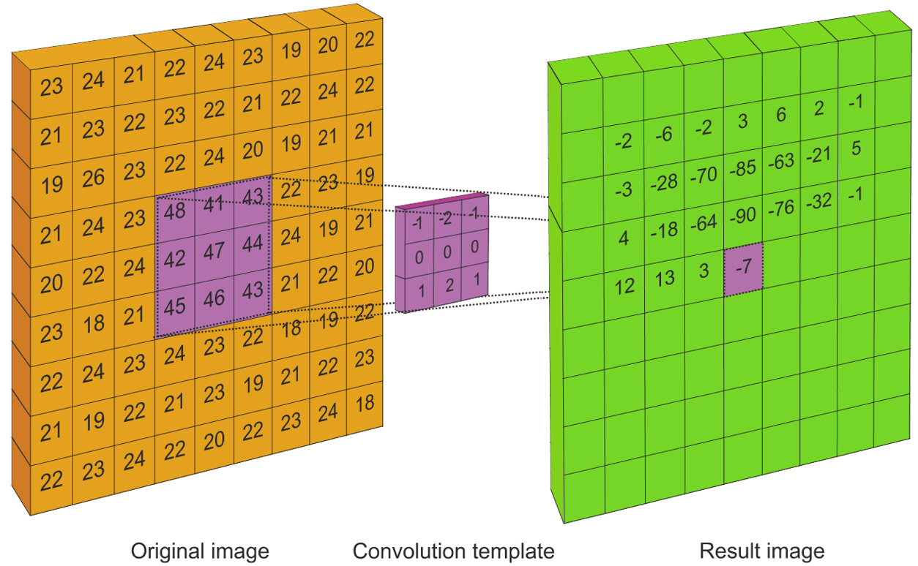

Template convolution
Calculate a new image from the original
Template is convolved in a raster fashion
Template is inverted for convolution

Slide 4
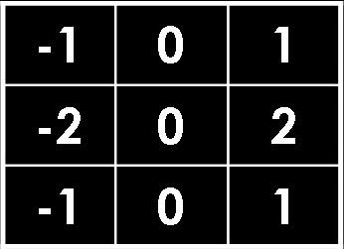
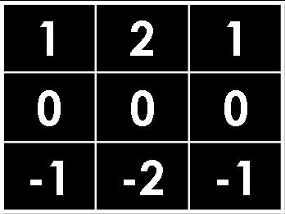
Template convolution
100 | 100 | 200 | 200 | 200
100 | 100 | 200 | 200 | 200
100 | 100 | 200 | 200 | 200
200 | 200 | 400 | 400 | 400
300 | 300 | 400 | 400 | 400
0 | 0 | 0 | 0 | 0
0 |  |  |  | 0
0 |  |  |  | 0
0 |  |  |  | 0
0 | 0 | 0 | 0 | 0
400
400
0
Image
400
400
0
G_{y}
400
400
0
0 | 0 | 0 | 0 | 0
0 | 400 | 400 | 0 | 0
0 | 640 | 806 | 800 | 0
0 | 894 | 894 | 800 | 0
0 | 0 | 0 | 0 | 0
0 | 0 | 0 | 0 | 0
0 |  |  |  | 0
0 |  |  |  | 0
0 |  |  |  | 0
0 | 0 | 0 | 0 | 0
0
0
0
Inverted template
Result
500
700
800
G_{x}
800
800
800

Slide 5
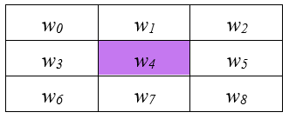


3×3 template and weighting coefficients
where $w_{i,j}$ are the weights and $x\left(i\right),y\left(j\right)$ denote the position of the point that matches the weighting coefficient position
Result calculated for centre point

Slide 6
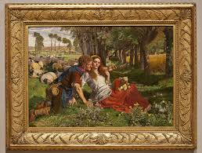
Border?
Three options
Set border to black
Assume wrap-around
Make template smaller near edges
Normally we assume object of interest is near centre so set border to black

Slide 7

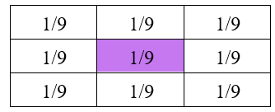


3×3 averaging operator
5×5, w = 1/25 and 7×7, w = 1/49 etc.

Slide 8


Illustrating the effect of window size
3×3
5×5
7×7
Larger operators remove more noise, but lose more detail

Slide 9
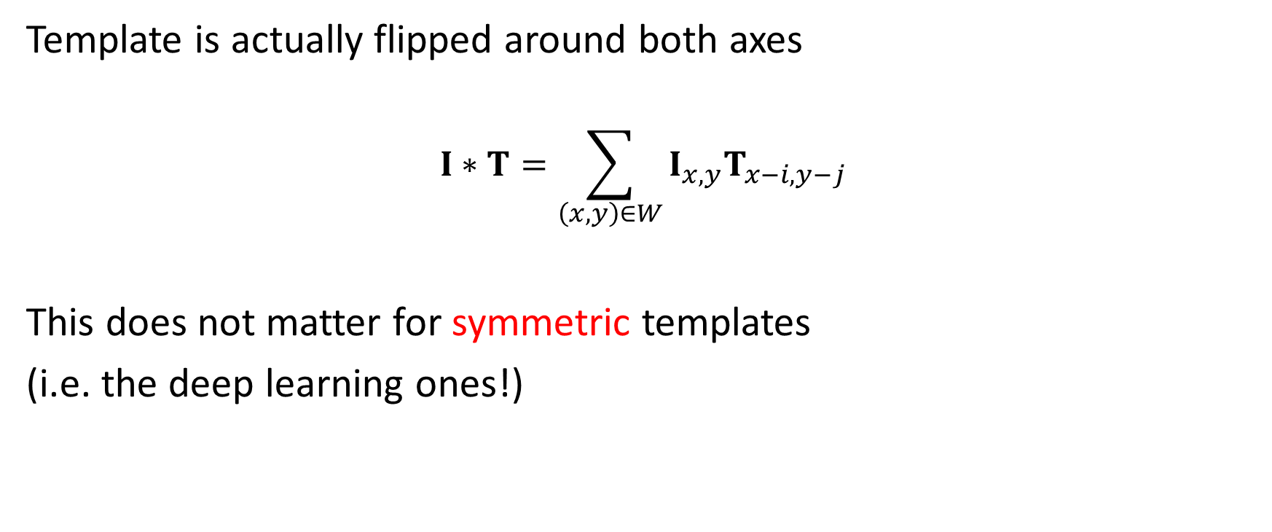
Nasty bit ….
Template is actually flipped around both axes
$$I∗T=\sum_{\left(x,y\right)∈W}{I_{x,y}T_{x−i,y−j}}$$
This does not matter for symmetric templates
(i.e. the deep learning ones!)

Slide 10



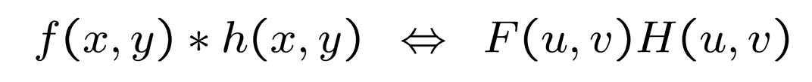
Template convolution via the Fourier transform
Convolution theorem allows for fast computation via FFT for template size ≥ 7×7
The inversion is implicit in Fourier
The theory is at end, for information only
Point by point multiplication (∙×) for sampled signals
This is fast!!
Beware of clowns … Oxford
Imperial
it’s point by point!!

Slide 11
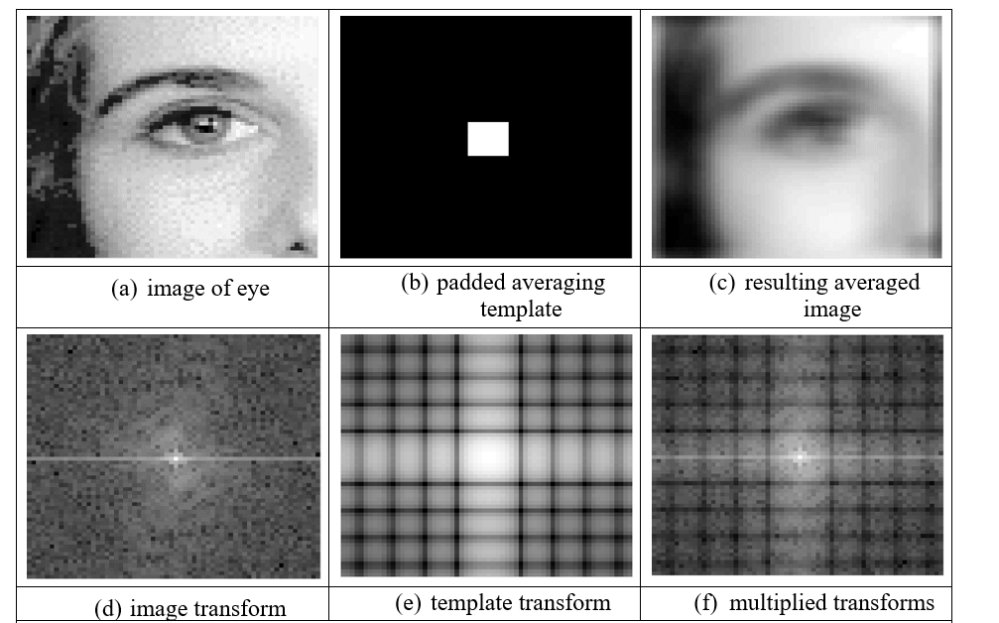
Template Convolution via the Fourier Transform

Slide 12
Fireside time
Biometrics – Southampton on ABC news for the second time ….
GAIT Biometric Smart Cameras to ID Americans
https://www.youtube.com/watch?v=6KuMe5n_jdQ

Slide 13
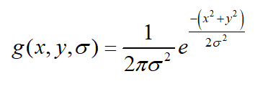

2D Gaussian function
Used to calculate template values
Note compromise between variance and window size
Common choices 5×5, 1.0; 7×7, 1.2; 9×9, 1.4

Slide 14
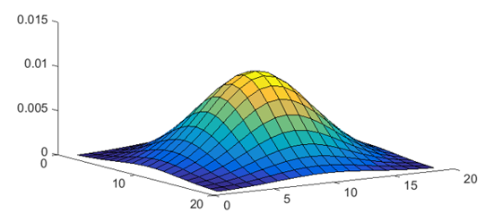
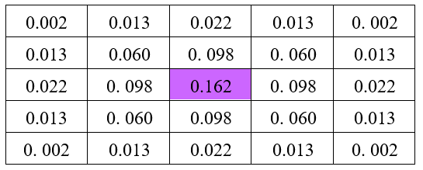
2D Gaussian function and template

Slide 15
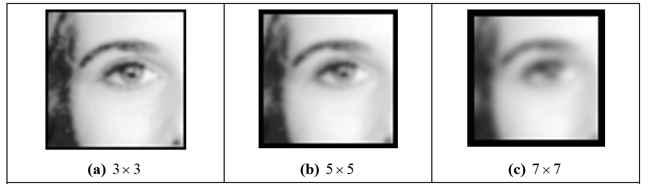
Applying Gaussian averaging

Slide 16
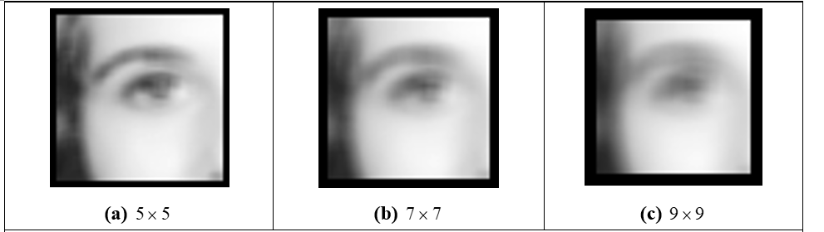
Comparison
Direct averaging
Which one is better?
Gaussian averaging

Slide 17
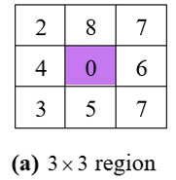
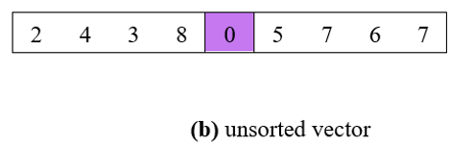
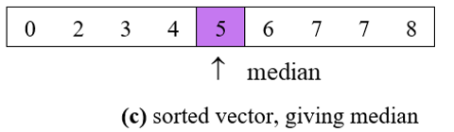
Finding the median from a 3×3 template
The median is the centre element of a rank-ordered set of template points

Slide 18
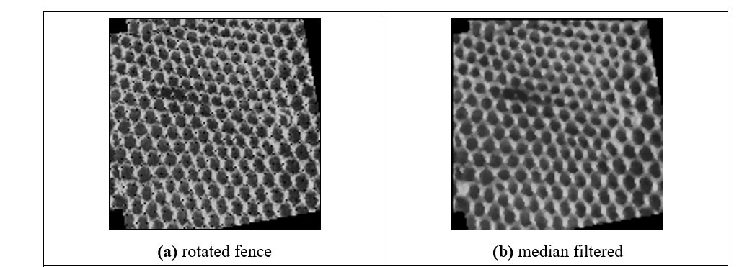
Finding the median from a 3×3 template
Preserves edges
Removes salt and pepper noise

Slide 19
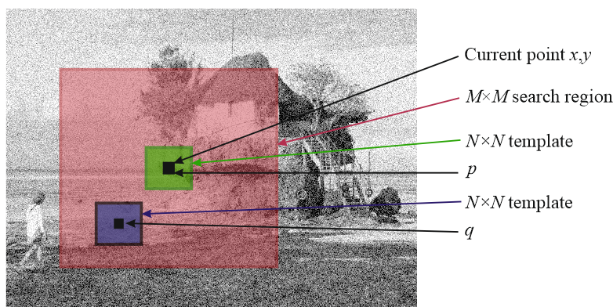
Newer stuff: non local means
Averaging which preserves regions

Slide 20
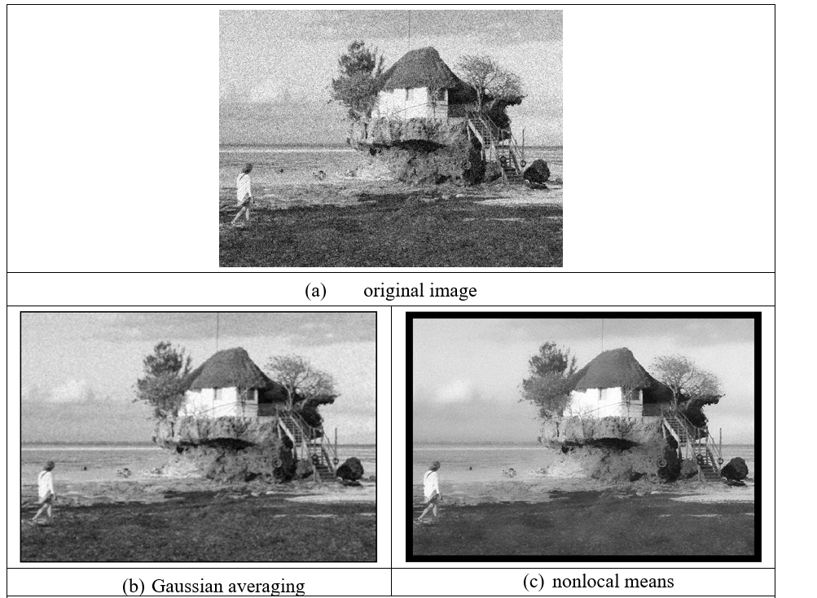
Applying non local means

Slide 21
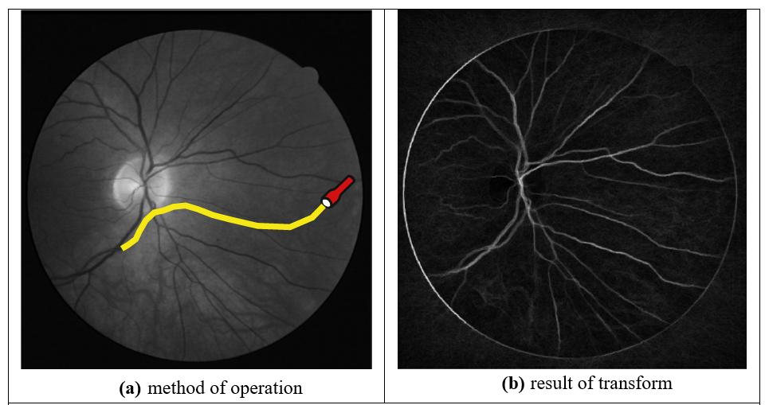
Even newer stuff: Image Ray Transform
Use analogy to light to find shapes, removing remainder
Cummings, Nixon and Prugel-Bennett, PRL 2012

Slide 22
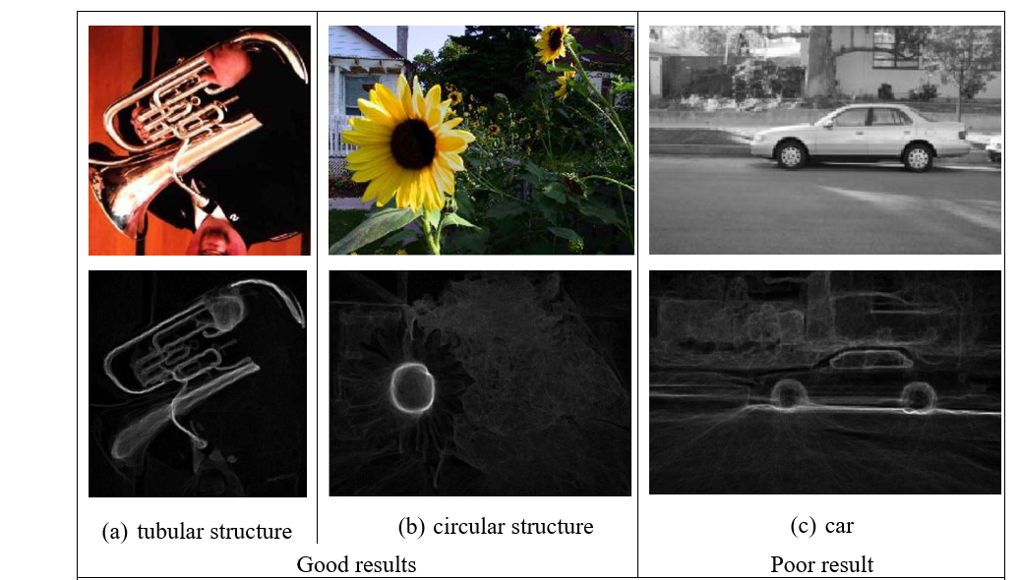
Applying Image Ray Transform

Slide 23
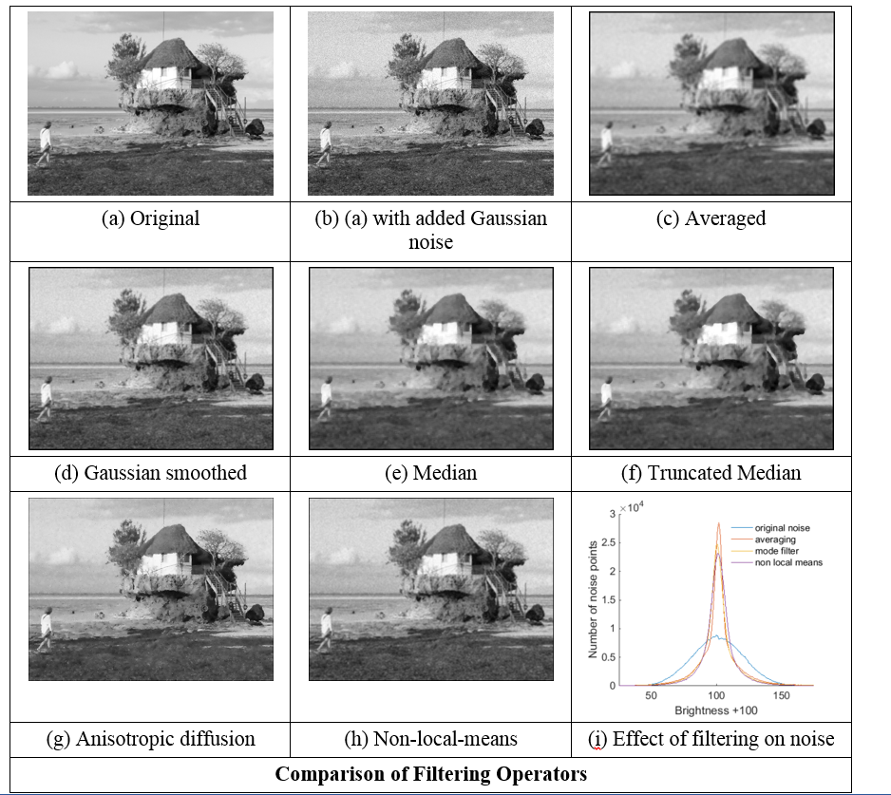

Slide 24

Takeaway time
1 – collection of points is called a template
2 – application to an image is called template convolution
3 - can use Fourier to improve speed
4 – averaging reduces noise
How do we find features? That’s edge detection, coming next
Notes:
Bookjshop alehouse (only takeaway)

Slide 26
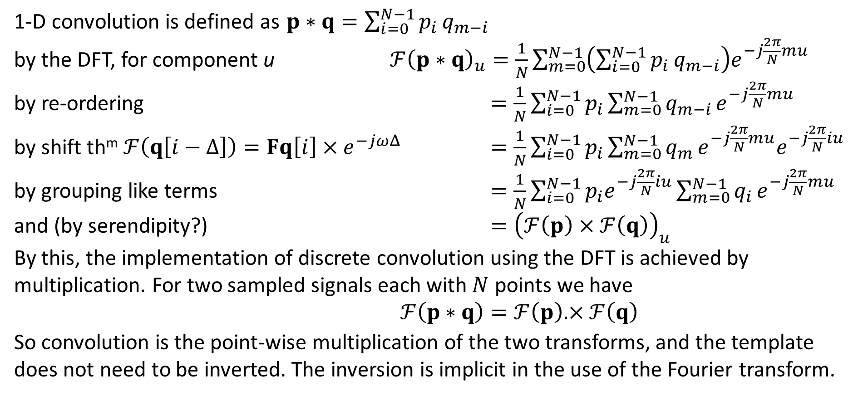
Convolution theorem, for completeness only!
1-D convolution is defined as $p∗q=\sum_{i=0}^{N−1}{p_{i}}q_{m−i}$
by the DFT, for component u $ℱ{\left(p∗q\right)}_{u}=\frac{1}{N}\sum_{m=0}^{N−1}{\left(\sum_{i=0}^{N−1}{p_{i}}q_{m−i}\right)e^{−j\frac{2π}{N}mu}}$
by re-ordering $=\frac{1}{N}\sum_{i=0}^{N−1}{p_{i}}\sum_{m=0}^{N−1}{q_{m−i}}e^{−j\frac{2π}{N}mu}$
by shift th^{m} $ℱ\left(q\left[i−Δ\right]\right)=Fq\left[i\right]×e^{−jωΔ}$ $=\frac{1}{N}\sum_{i=0}^{N−1}{p_{i}}\sum_{m=0}^{N−1}{q_{m}}e^{−j\frac{2π}{N}mu}e^{−j\frac{2π}{N}iu}$
by grouping like terms $=\frac{1}{N}\sum_{i=0}^{N−1}{p_{i}e^{−j\frac{2π}{N}iu}}\sum_{m=0}^{N−1}{q_{i}}e^{−j\frac{2π}{N}mu}$
and (by serendipity?) $={\left(ℱ\left(p\right)×ℱ\left(q\right)\right)}_{u}$
By this, the implementation of discrete convolution using the DFT is achieved by multiplication. For two sampled signals each with $N$ points we have
$ℱ\left(p∗q\right)=ℱ\left(p\right).×ℱ\left(q\right)$
So convolution is the point-wise multiplication of the two transforms, and the template does not need to be inverted. The inversion is implicit in the use of the Fourier transform.

